Slide 1
SOFTWARE PROJECT MANAGEMENT

Slide 2
Vision and scope document outline
1. Problem Statement
a. Project background
b. Stakeholders
c. Users
d. Risks
e. Assumptions
2. Vision of the Solution
a. Vision statement
b. List of features
c. Scope of phased release (optional)
d. Features that will not be developed

Slide 3
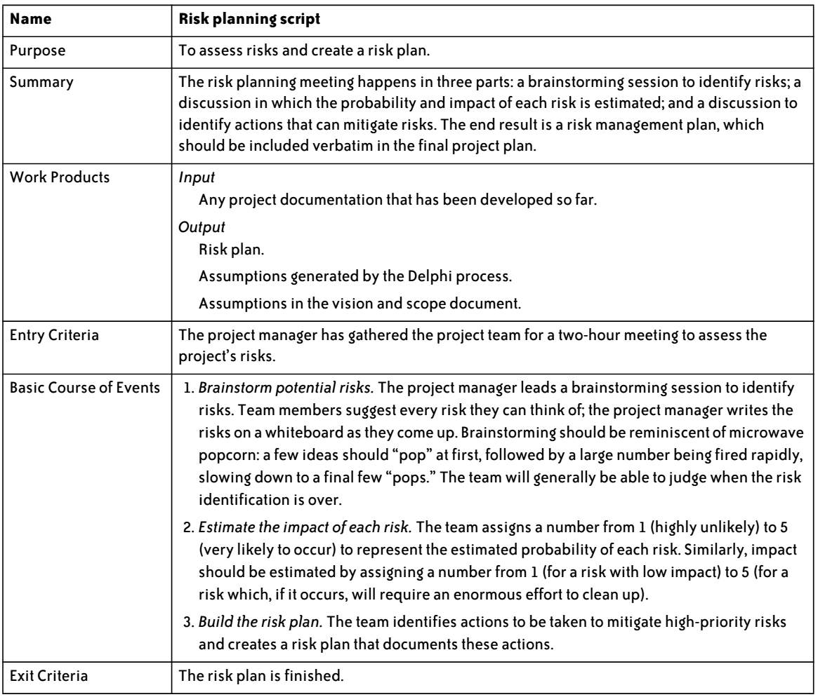
Risk planning script

Slide 4
Project Plan Inspection Checklist
Statement of work
Does the project plan include a statement of work (SOW)?
Is the SOW complete—does it contain all of the features that will be developed?
Are all work products represented?
If estimates are known, have they been included?
Resources
Does the project plan include a resource list?
Does the resource list contain all resources available to the project?

Slide 5
Contd..
Are there any resources known to be assigned to other projects at the same time that they are assigned to this one?
Have dates that the resources are unavailable (scheduled downtime for machines, vacations for people, times that facilities cannot be booked, etc.) been taken into account?
Project schedule
Does the project plan include a schedule?
Are there any tasks that are missing or incorrect?
If a WBS was generated by a Delphi session, does the project schedule reflect all of the tasks that were identified by the team?

Slide 6
Contd..
Does each task have a predecessor?
Is a resource allocated to each task?
If multiple resources have been assigned to a single task, has the task’s duration been updated properly to reflect that?
Is there a more efficient way to allocate resources?
Does the project schedule contain periodic reviews?
Risk plan
Does the project plan include a risk plan?
Are there any risks that are not in the plan?

Slide 7
Contd..
Are there any assumptions (from the vision and scope document or a Delphi session) that represent risks that should be included in the plan?
Is each risk prioritized correctly?
Has the impact of each risk been estimated correctly?
Have the risks been sufficiently mitigated?

Slide 8
Lack of Leadership
Without good leadership, the team member might be afraid to make this decision. This usually results in the team member sending emails to peers, managers, stakeholders, and anyone else she can find, requesting confirmation of absolutely every little decision that gets made. People quickly get inundated with notes about project details that they lack the context to even understand.

Slide 9
Distrust in a software organization can be a serious, endemic problem.
A senior manager may decide that the team plans to spend too much time testing the software, even though the team reached consensus and all team members stand behind the estimates.
A project manager must be especially careful to explain this and support that consensus when senior managers start to pick apart the team’s estimates. If deadlines are handed down that do not allow enough time for the team to complete the work, it can lead to serious morale problems—and the project manager will be blamed for the delay, often by the same people who caused it in the first place.

Slide 10
Wideband Delphi Estimation
The Wideband Delphi estimation method was developed in the 1940s at the Rand Corporation as a forecasting tool.
It has since been adapted across many industries to estimate many kinds of tasks, ranging from statistical data collection results to sales and marketing forecasts.
It has proven to be a very effective estimation tool, and it lends itself well to software projects.

Slide 11
For Project Manager
The Wideband Delphi estimation process is especially useful to a project manager because it produces several important elements of the project plan. The most important product is the set of estimates upon which the project schedule is built.
Wideband Delphi works because it requires the entire team to correct one another in a way that helps avoid errors and poor estimation.

Slide 12
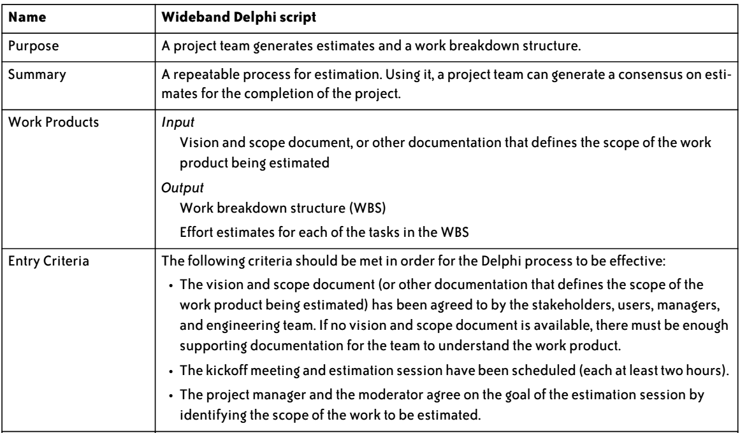
Wideband Delphi script

Slide 13
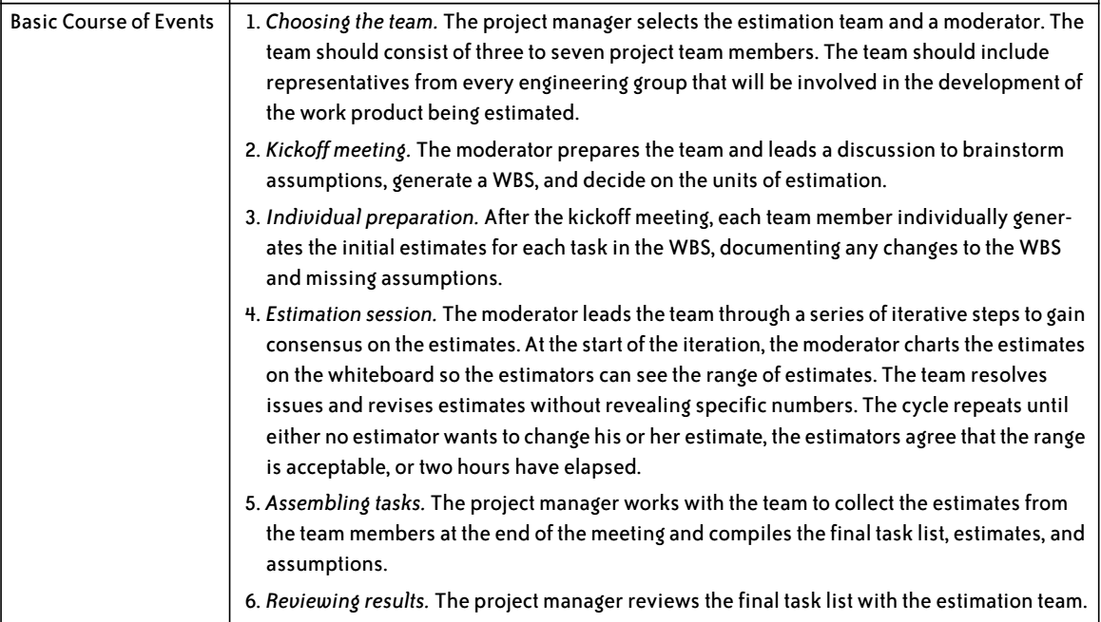
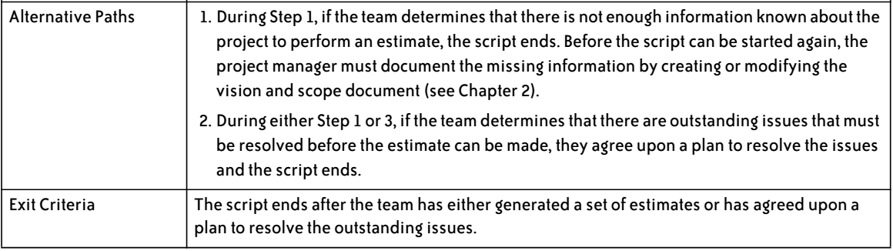
Contd..

Slide 14
Case Study : Risk Management Plan

